Slide 1


Network Models
Data Communications and Networking – Chapter 2
Adapted from Behrouz A. Forouzan, Data Communications and Networking, McGraw-Hill.

Slide 2
2-1 LAYERED TASKS
We use the concept of layers in our daily life. As an example, let us consider two friends who communicate through postal mail. The process of sending a letter to a friend would be complex if there were no services available from the post office.
Topics discussed in this section:
Sender, Receiver, and Carrier
Hierarchy

Slide 3
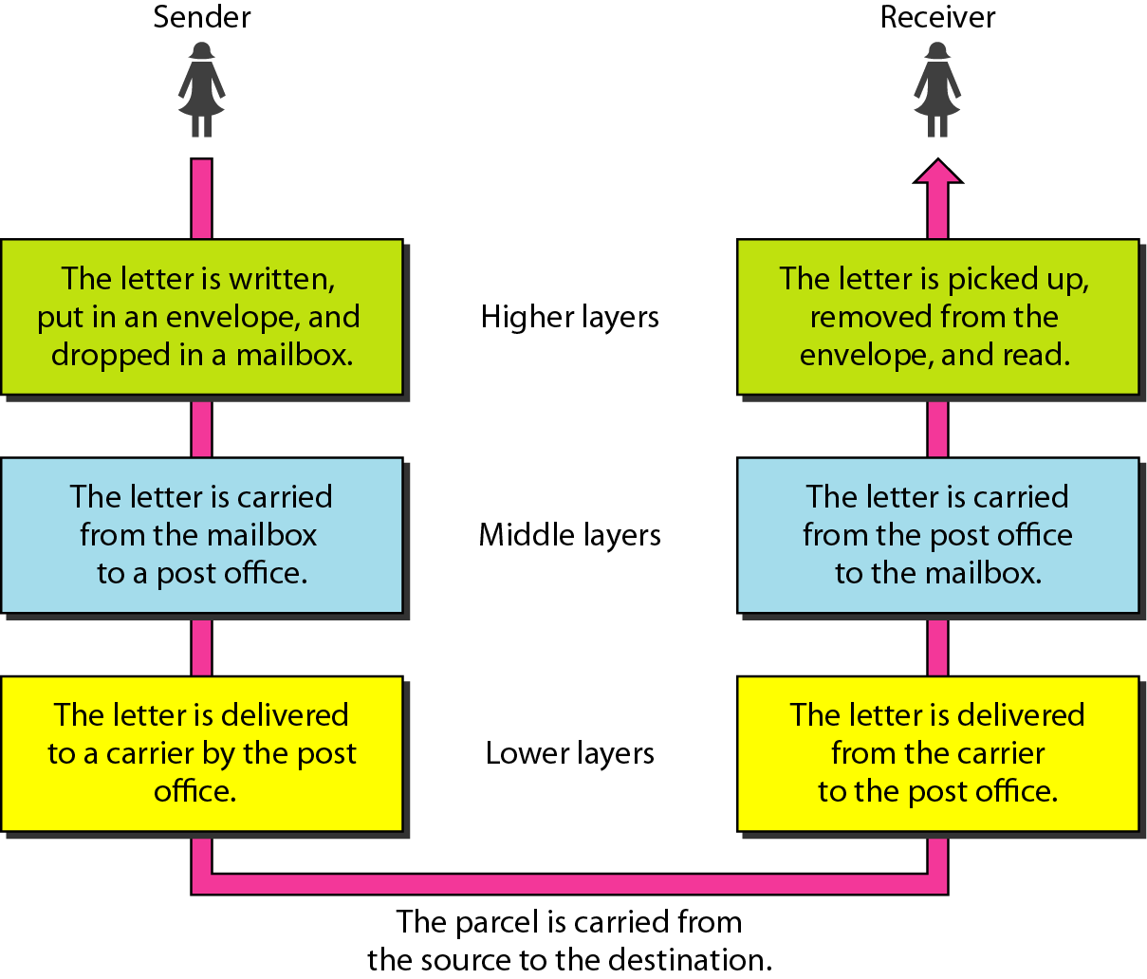
Figure 2.1 Tasks involved in sending a letter

Slide 4
2-2 THE OSI MODEL
Established in 1947, the International Standards Organization (ISO) is a multinational body dedicated to worldwide agreement on international standards. An ISO standard that covers all aspects of network communications is the Open Systems Interconnection (OSI) model. It was first introduced in the late 1970s.
Topics discussed in this section:
Layered Architecture
Peer-to-Peer Processes
Encapsulation

Slide 5

NOTE
ISO is the organization. OSI is the model.

Slide 6
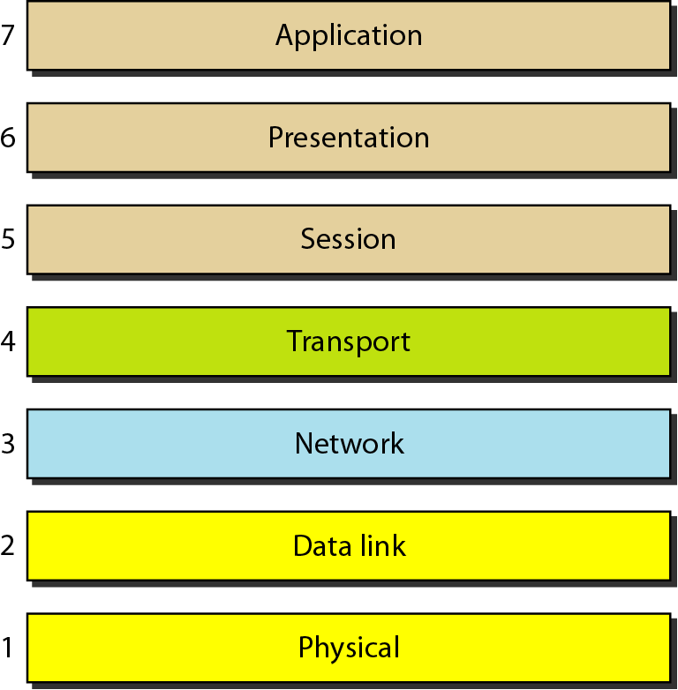
Figure 2.2 Seven layers of the OSI model

Slide 7
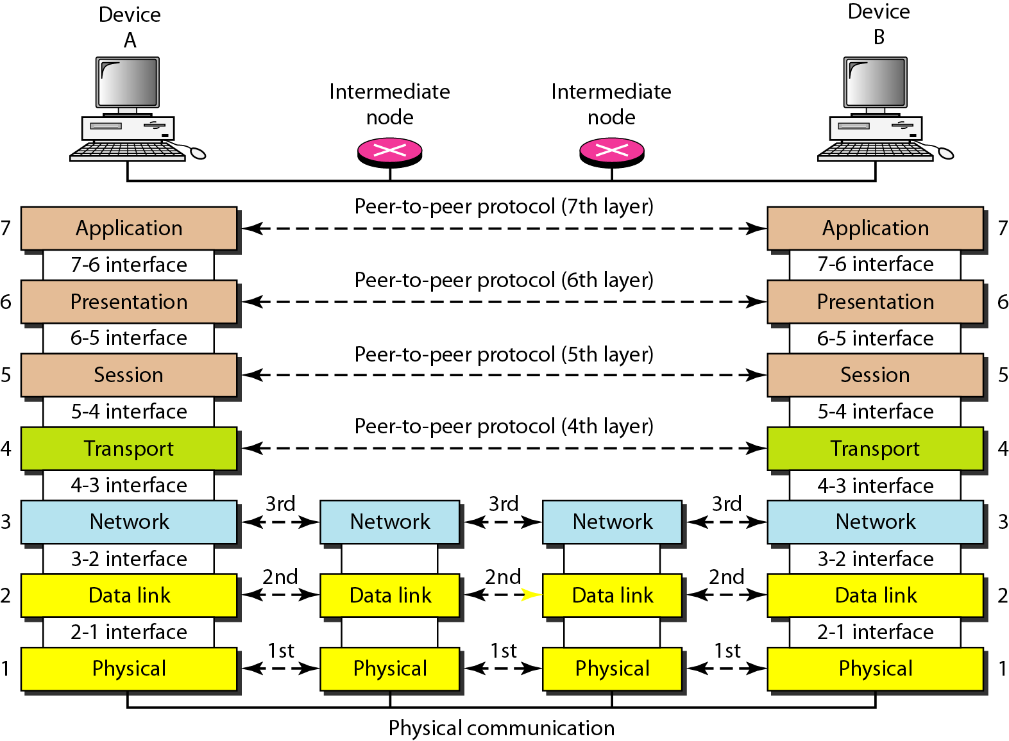
Figure 2.3 The interaction between layers in the OSI model

Slide 8
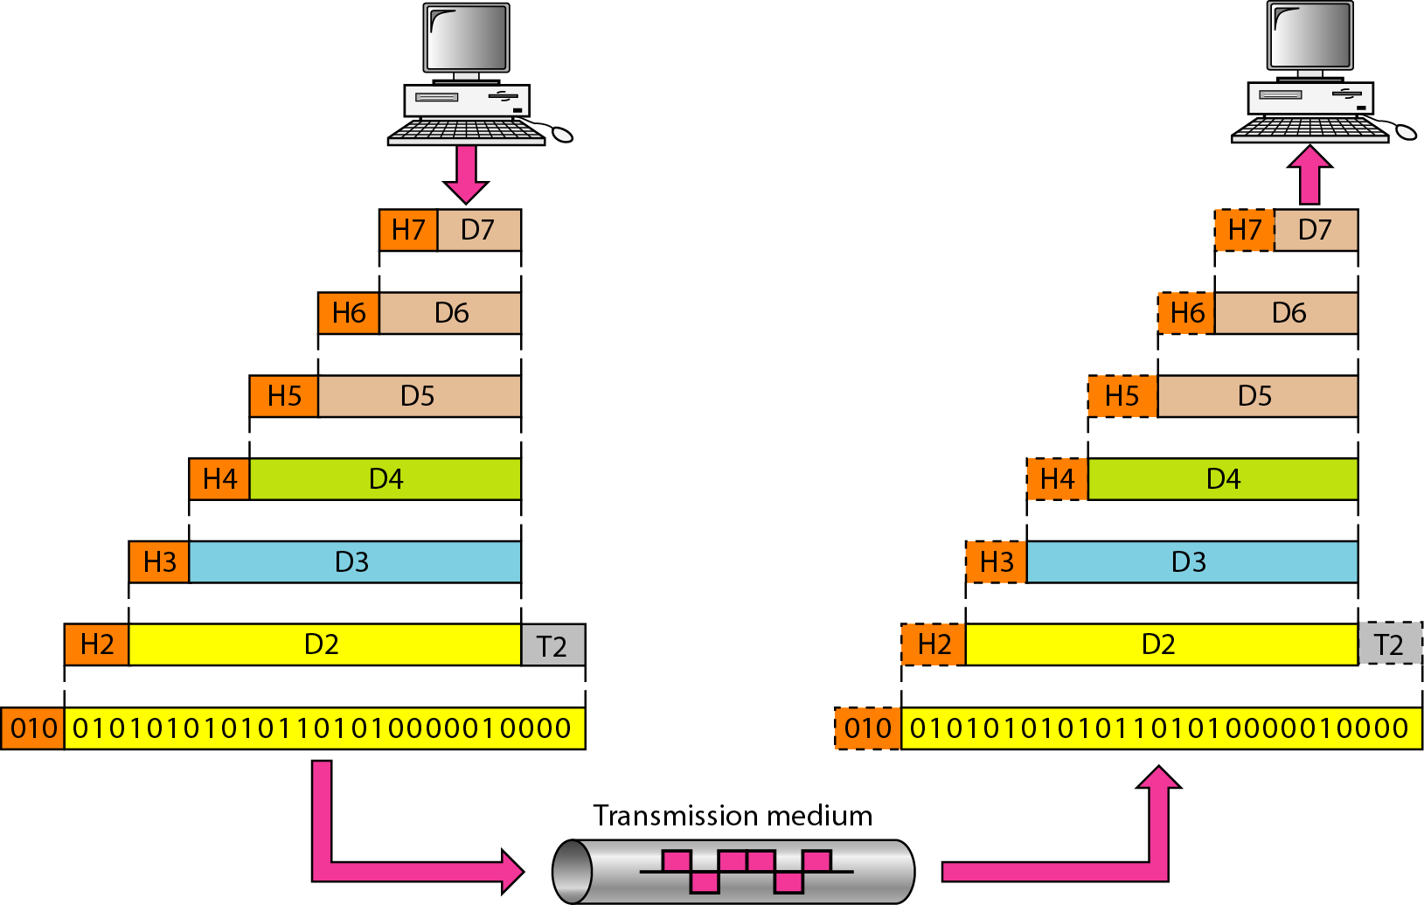
Figure 2.4 An exchange using the OSI model

Slide 9
2-3 LAYERS IN THE OSI MODEL
In this section we briefly describe the functions of each layer in the OSI model.
Topics discussed in this section:
Physical Layer
Data Link Layer
Network Layer
Transport Layer
Session Layer
Presentation Layer
Application Layer

Slide 10
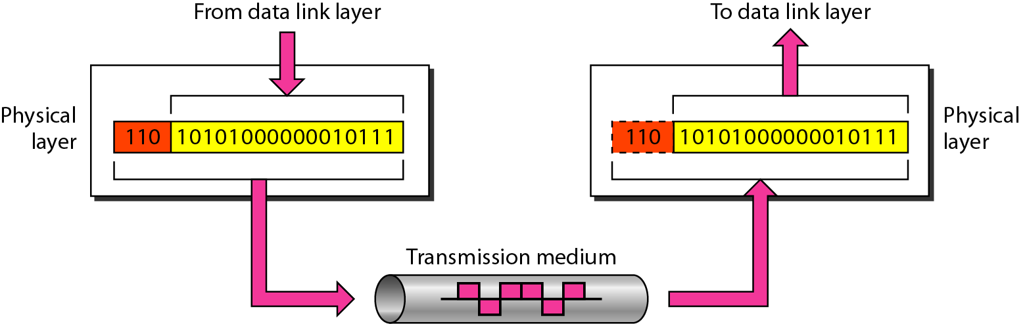
Figure 2.5 Physical layer

Slide 11
NOTE
The physical layer is responsible for movements of individual bits from one hop (node) to the next.

Slide 12
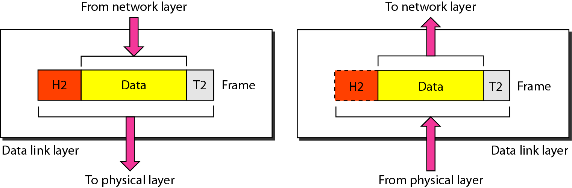
Figure 2.6 Data link layer

Slide 13
NOTE
The data link layer is responsible for moving frames from one hop (node) to the next.

Slide 14
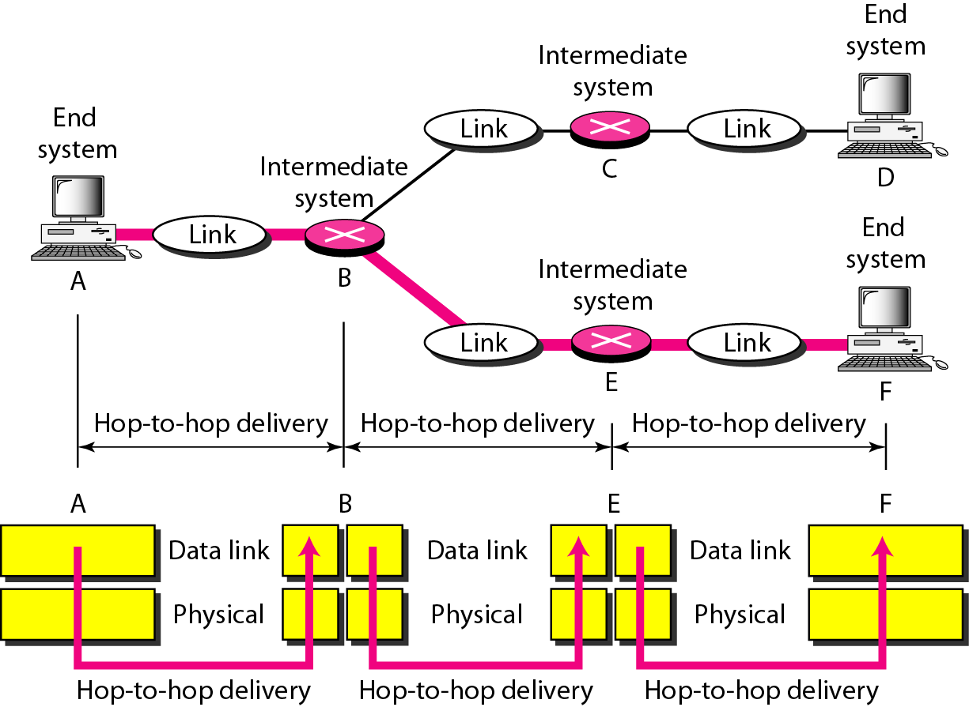
Figure 2.7 Hop-to-hop delivery

Slide 15
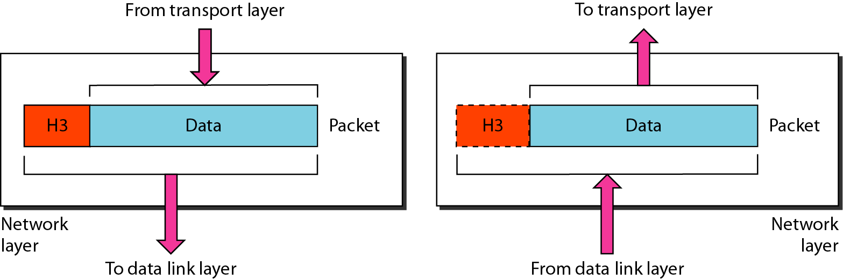
Figure 2.8 Network layer

Slide 16
NOTE
The network layer is responsible for the delivery of individual packets from the source host to the destination host.

Slide 17
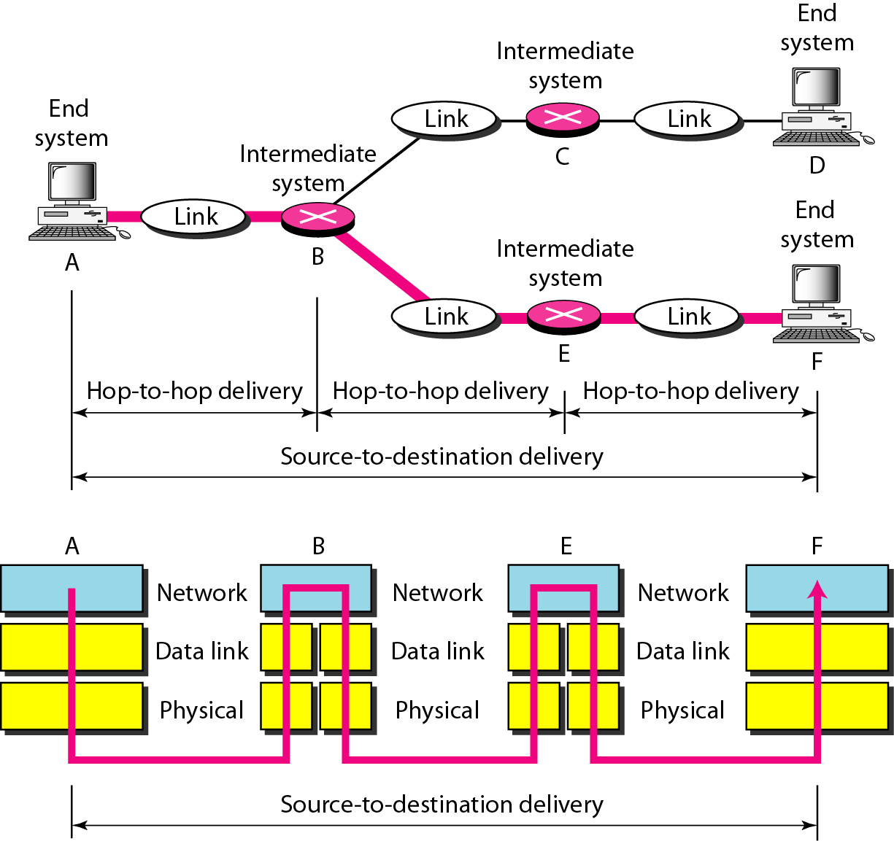
Figure 2.9 Source-to-destination delivery

Slide 18
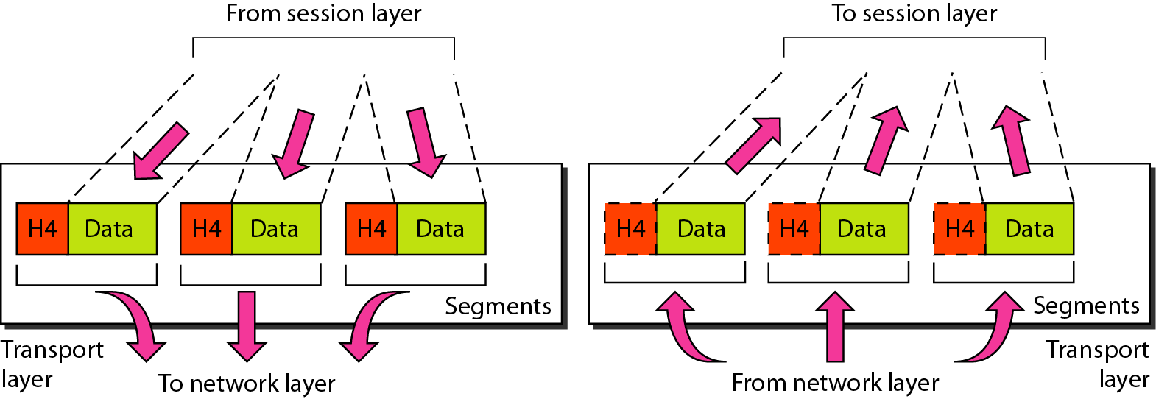
Figure 2.10 Transport layer

Slide 19
NOTE
The transport layer is responsible for the delivery of a message from one process to another.

Slide 20
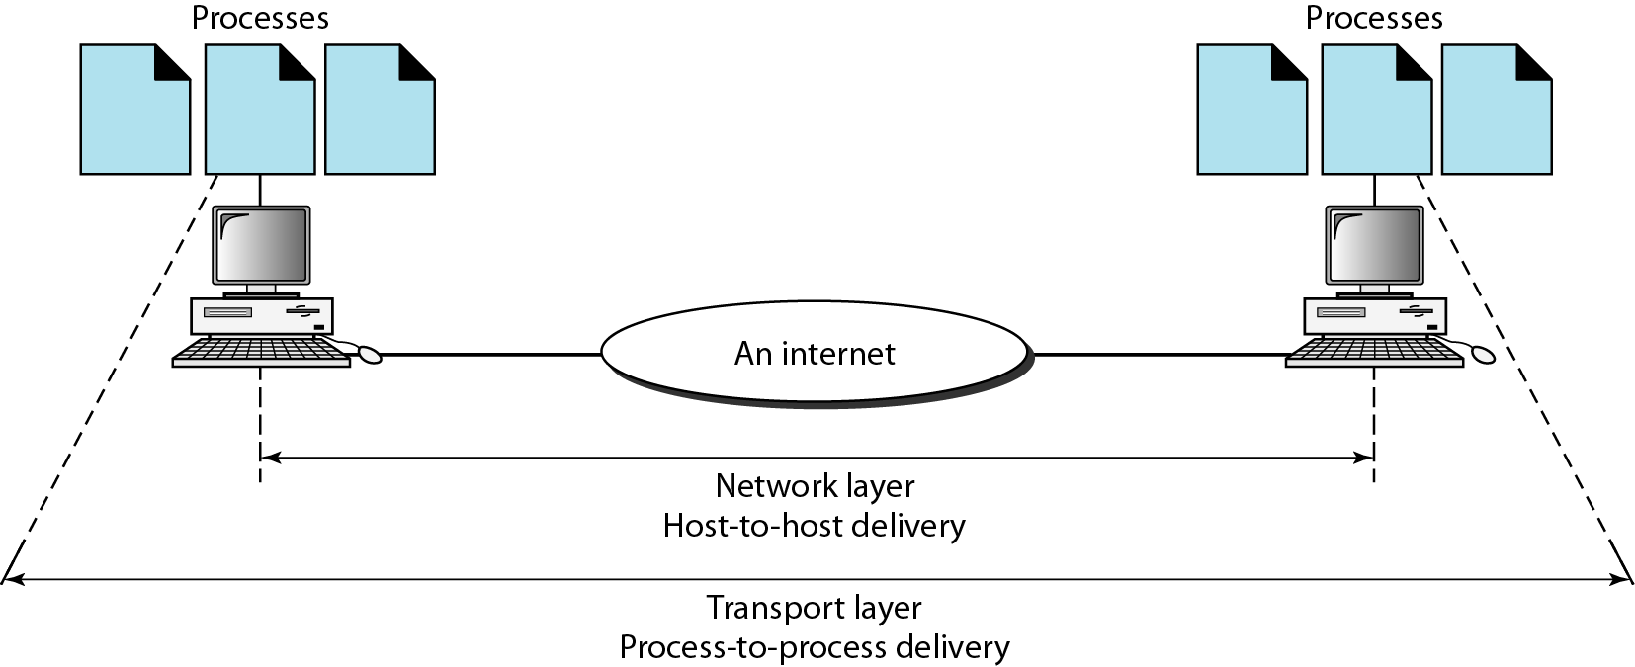
Figure 2.11 Reliable process-to-process delivery of a message

Slide 21
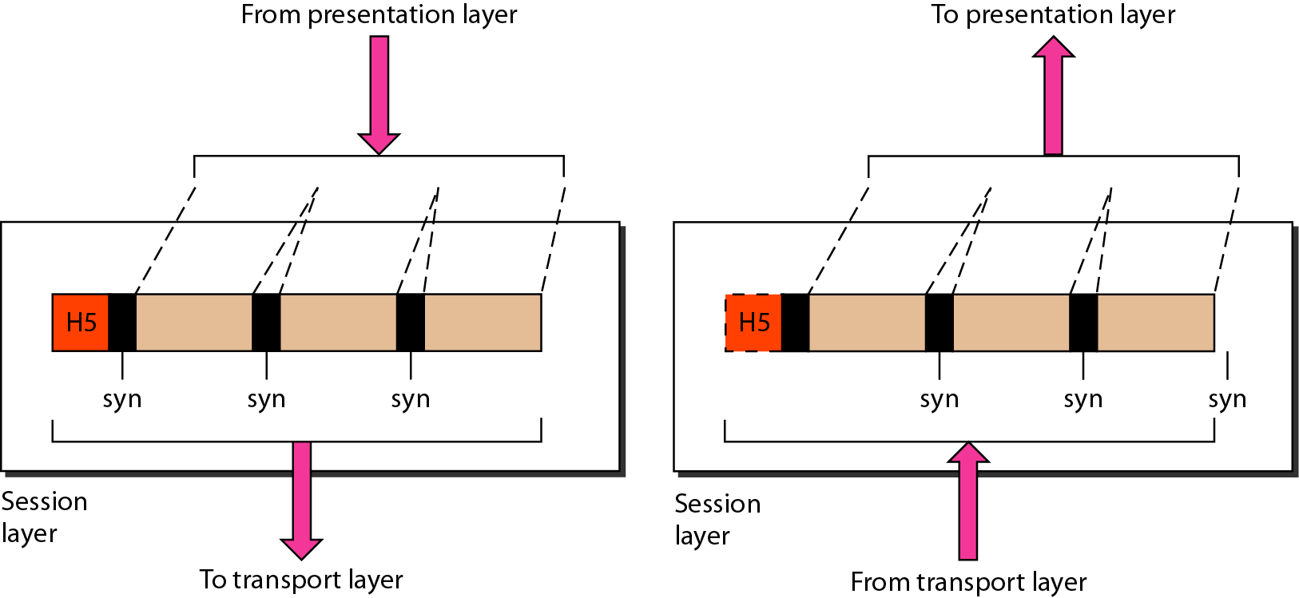
Figure 2.12 Session layer

Slide 22
NOTE
The session layer is responsible for dialog control and synchronization.

Slide 23
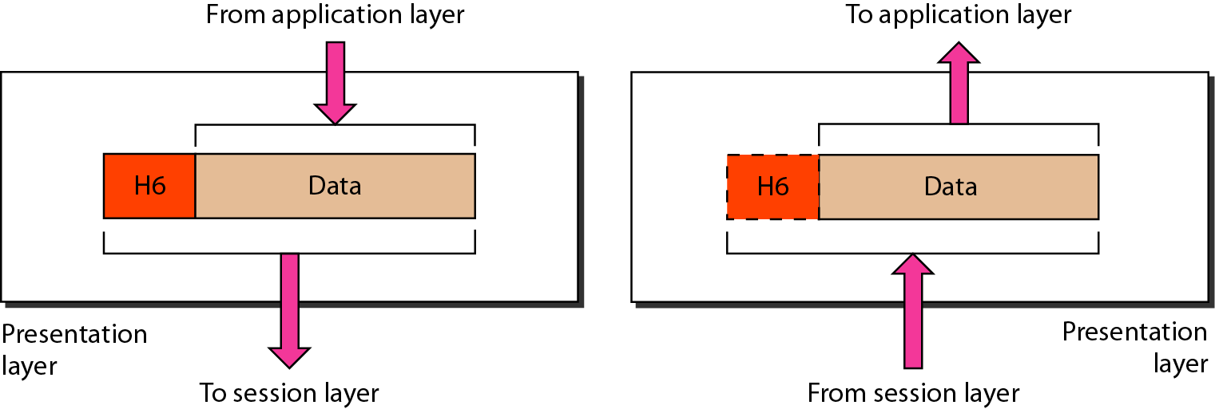
Figure 2.13 Presentation layer

Slide 24
NOTE
The presentation layer is responsible for translation, compression, and encryption.

Slide 25
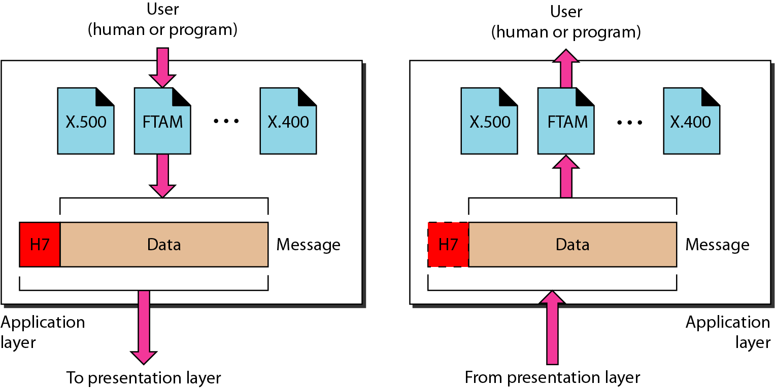
Figure 2.14 Application layer

Slide 26
NOTE
The application layer is responsible for providing services to the user.

Slide 27
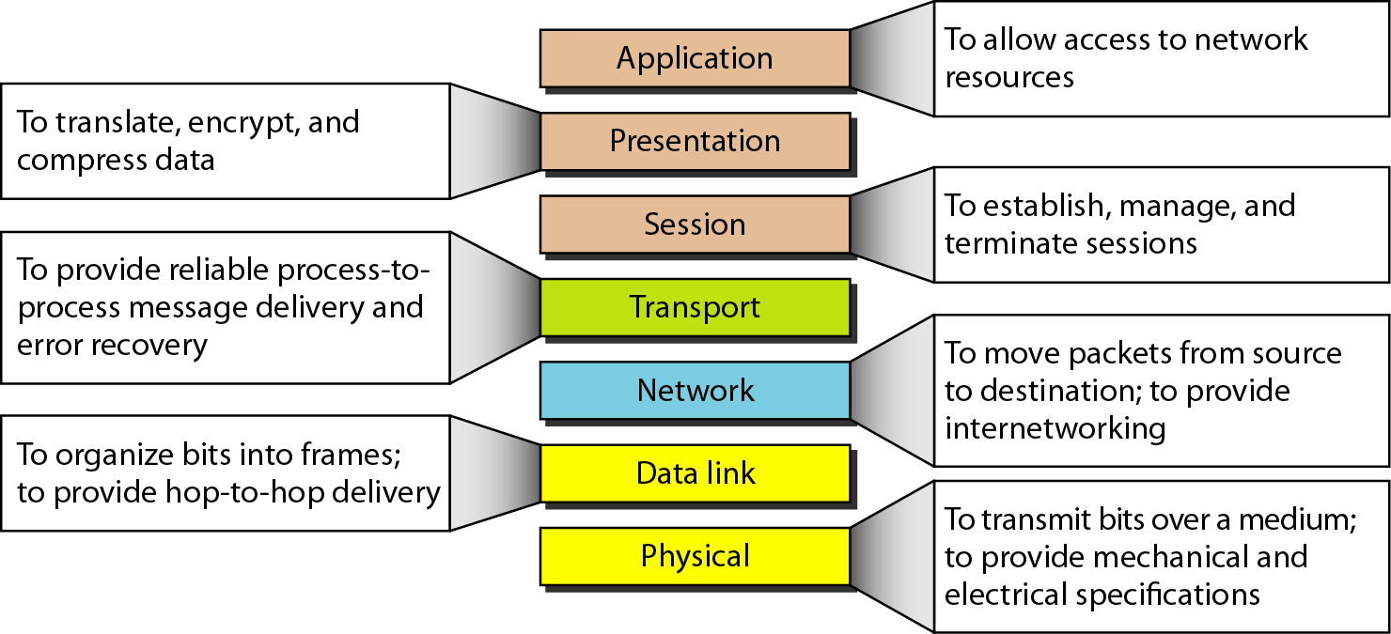
Figure 2.15 Summary of layers

Slide 28
2-4 TCP/IP PROTOCOL SUITE
The layers in the TCP/IP protocol suite do not exactly match those in the OSI model. The original TCP/IP protocol suite was defined as having four layers: host-to-network, internet, transport, and application. However, when TCP/IP is compared to OSI, we can say that the TCP/IP protocol suite is made of five layers: physical, data link, network, transport, and application.
Topics discussed in this section:
Physical and Data Link Layers
Network Layer
Transport Layer
Application Layer

Slide 29
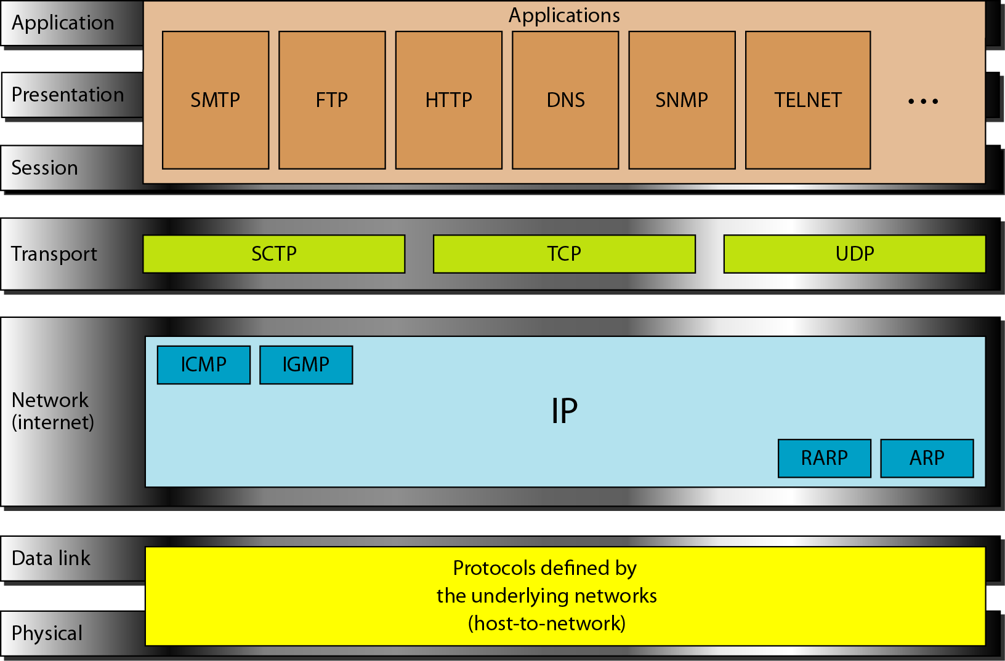
Figure 2.16 TCP/IP and OSI model

Slide 30
2-5 ADDRESSING
Four levels of addresses are used in an internet employing the TCP/IP protocols: physical, logical, port, and specific.
Topics discussed in this section:
Physical Addresses
Logical Addresses
Port Addresses
Specific Addresses

Slide 31
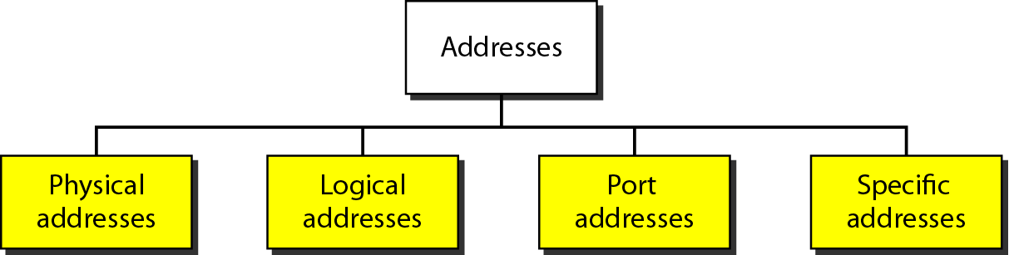
Figure 2.17 Addresses in TCP/IP

Slide 32
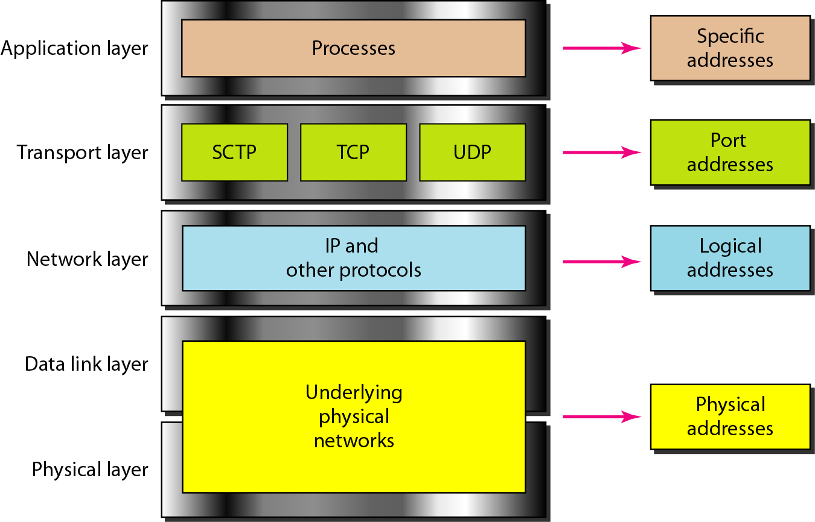
Figure 2.18 Relationship of layers and addresses in TCP/IP

Slide 33
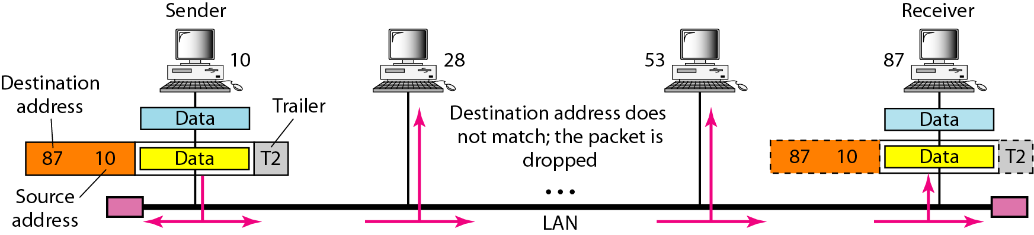
Example 2.1
In Figure 2.19 a node with physical address 10 sends a frame to a node with physical address 87. The two nodes are connected by a link (bus topology LAN). As the figure shows, the computer with physical address 10 is the sender, and the computer with physical address 87 is the receiver.

Slide 34
Figure 2.19 Physical addresses

Slide 35
Example 2.2
Most local-area networks use a 48-bit (6-byte) physical address written as 12 hexadecimal digits; every byte (2 hexadecimal digits) is separated by a colon, as shown below:
07:01:02:01:2C:4B
A 6-byte (12 hexadecimal digits) physical address.

Slide 36
Example 2.3
Figure 2.20 shows a part of an internet with two routers connecting three LANs. Each device (computer or router) has a pair of addresses (logical and physical) for each connection. In this case, each computer is connected to only one link and therefore has only one pair of addresses. Each router, however, is connected to three networks (only two are shown in the figure). So each router has three pairs of addresses, one for each connection.

Slide 37
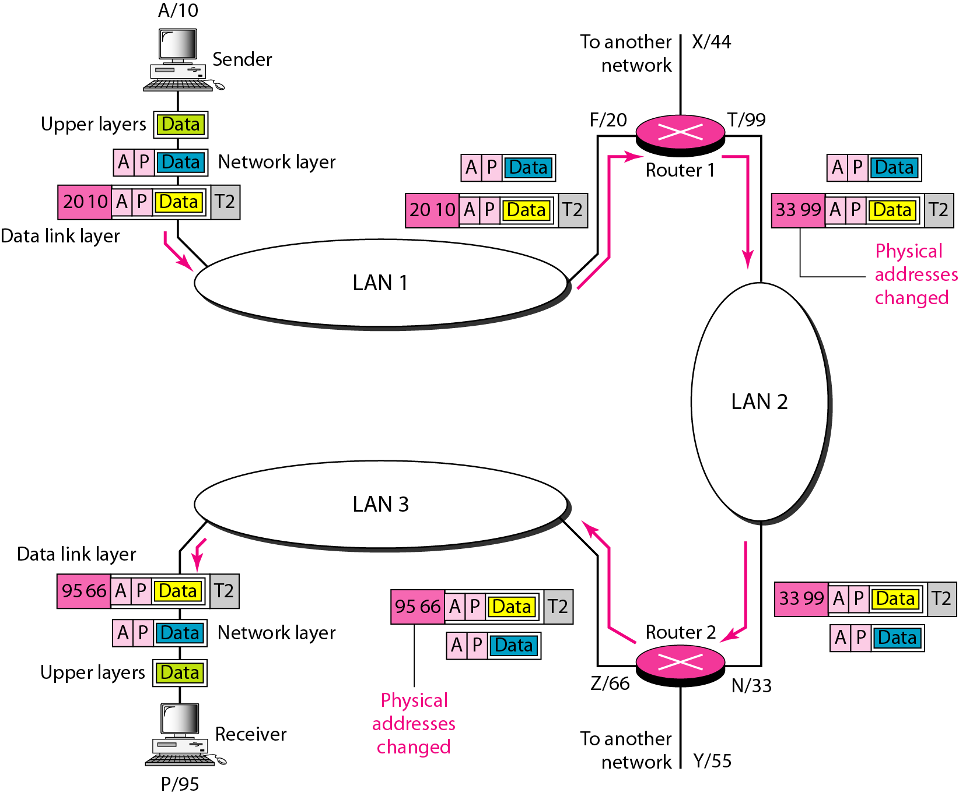
Figure 2.20 IP addresses

Slide 38
Example 2.4
Figure 2.21 shows two computers communicating via the Internet. The sending computer is running three processes at this time with port addresses a, b, and c. The receiving computer is running two processes at this time with port addresses j and k. Process a in the sending computer needs to communicate with process j in the receiving computer. Note that although physical addresses change from hop to hop, logical and port addresses remain the same from the source to destination.

Slide 39
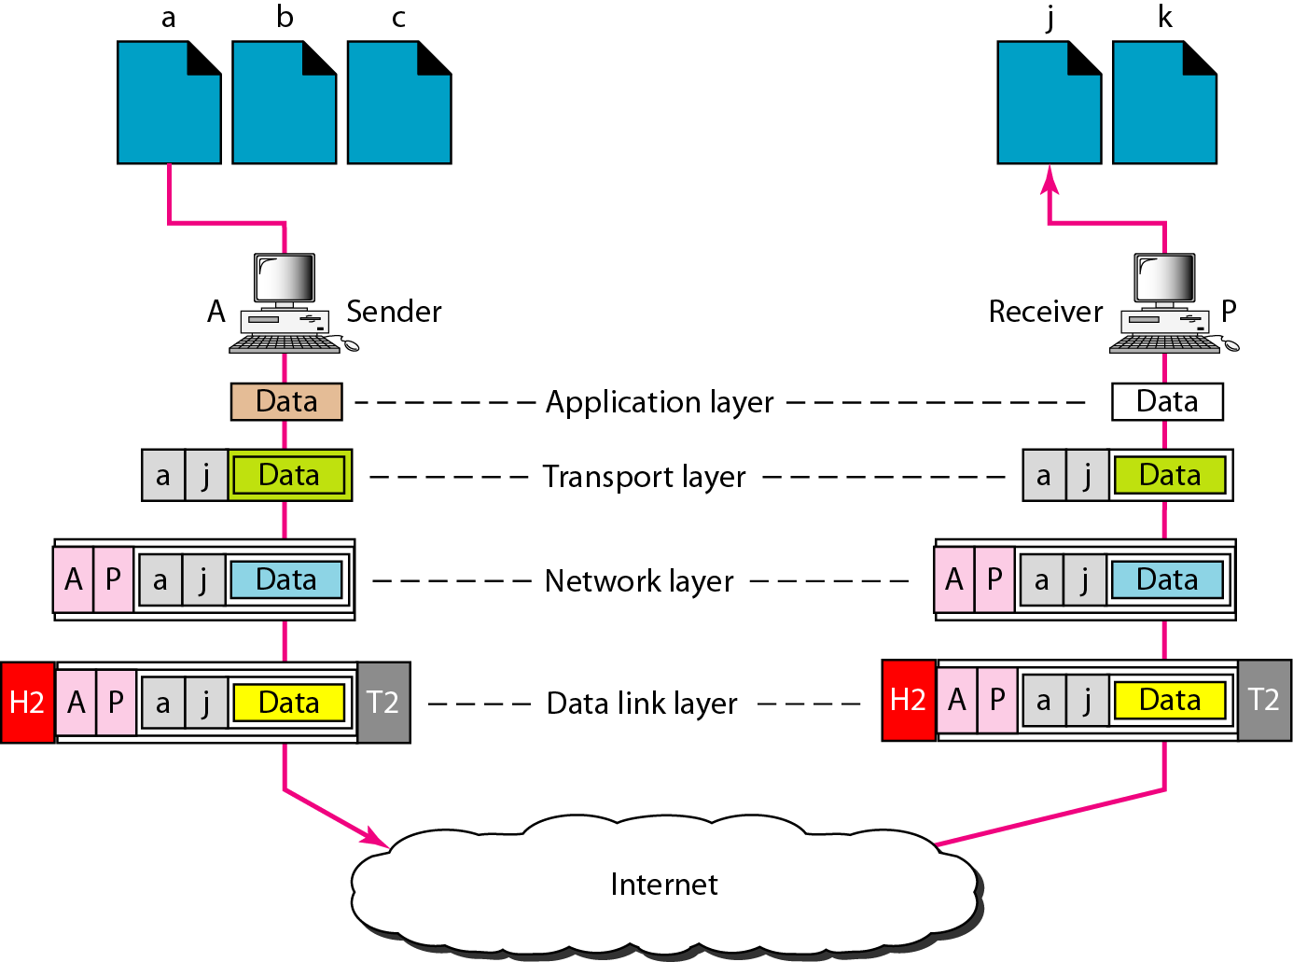
Figure 2.21 Port addresses

Slide 40
NOTE
The physical addresses will change from hop to hop, but the logical addresses usually remain the same.

Slide 41
Example 2.5
A port address is a 16-bit address represented by one decimal number as shown.
753
A 16-bit port address represented as one single number.

Slide 42
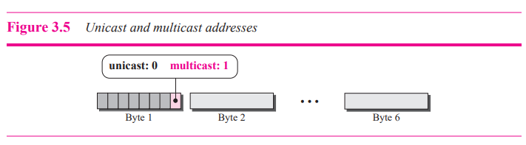
Unicast, Multicast, and Broadcast Addresses
A source address is always a unicast address—the frame comes from only one station. The destination address, however, can be unicast, multicast, or broadcast.
A unicast destination address defines only one recipient; the relationship between the sender and the receiver is one-to-one. A multicast destination address defines a group of addresses; the relationship between the sender and the receivers is one-to-many. The broadcast address is a special case of the multicast address; the recipients are all the stations on the LAN. A broadcast destination address is forty-eight 1s

Slide 43
